Slide 1

List of Components Used

Slide 2
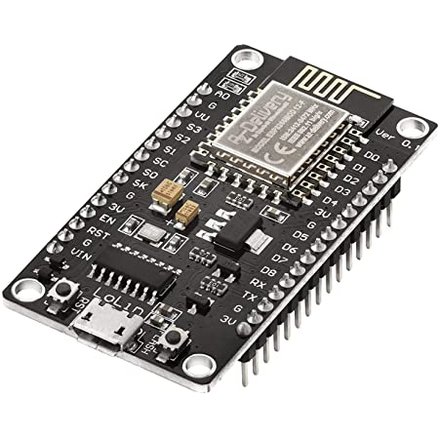
NodeMCU
ESP8266
Board

Slide 3
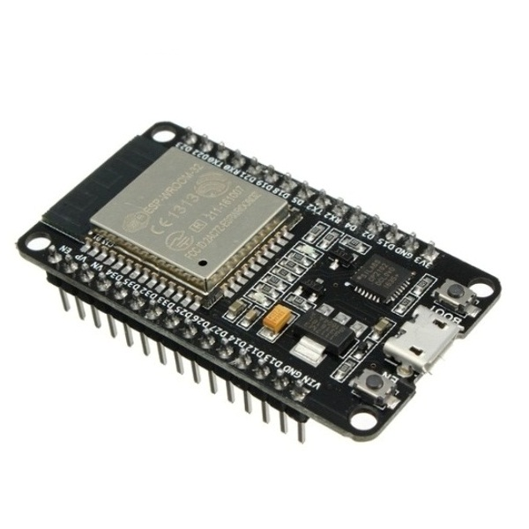
ESP-WROOM-32
Board

Slide 4
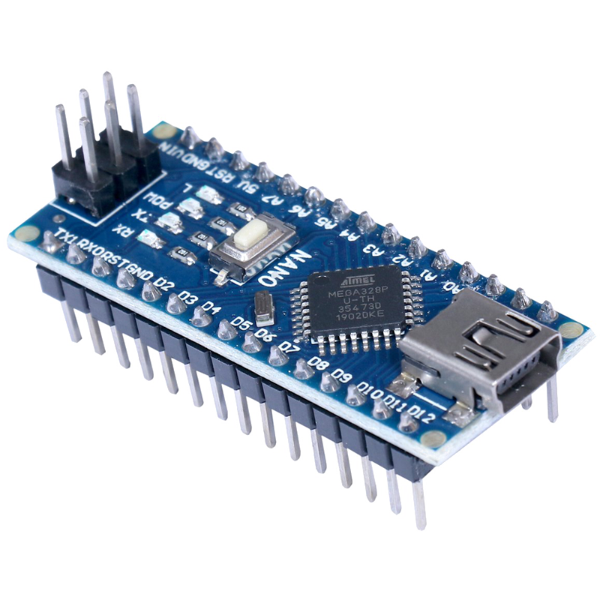
Arduino Nano

Slide 5
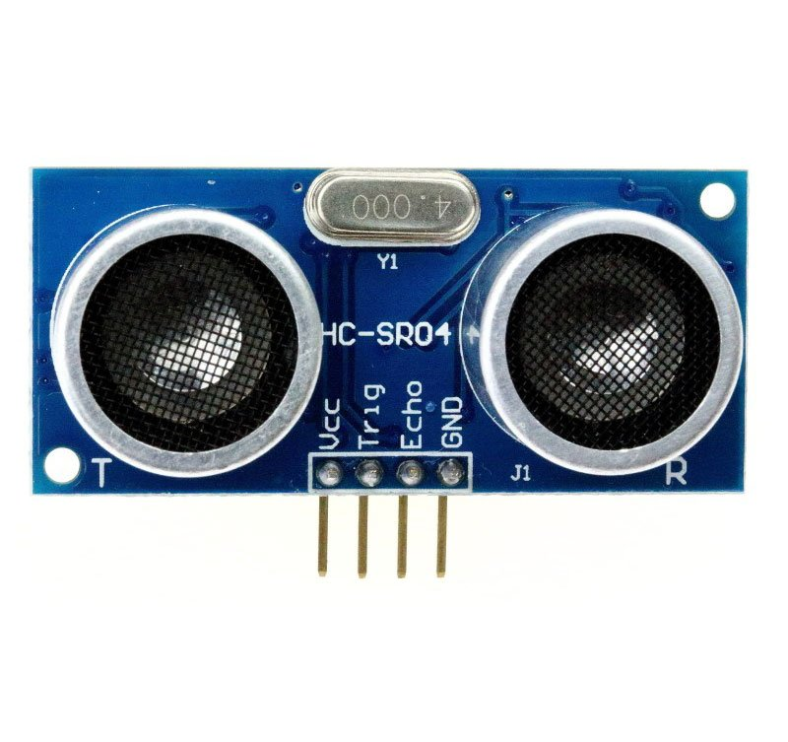
Ultrasonic Sensor
(HC-SR04)

Slide 6
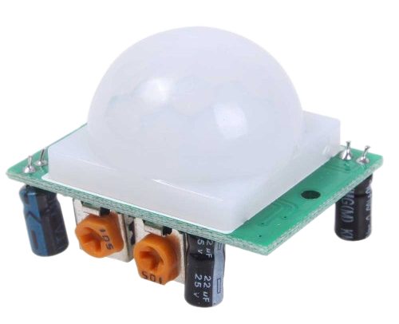
PIR Motion Sensor

Slide 7
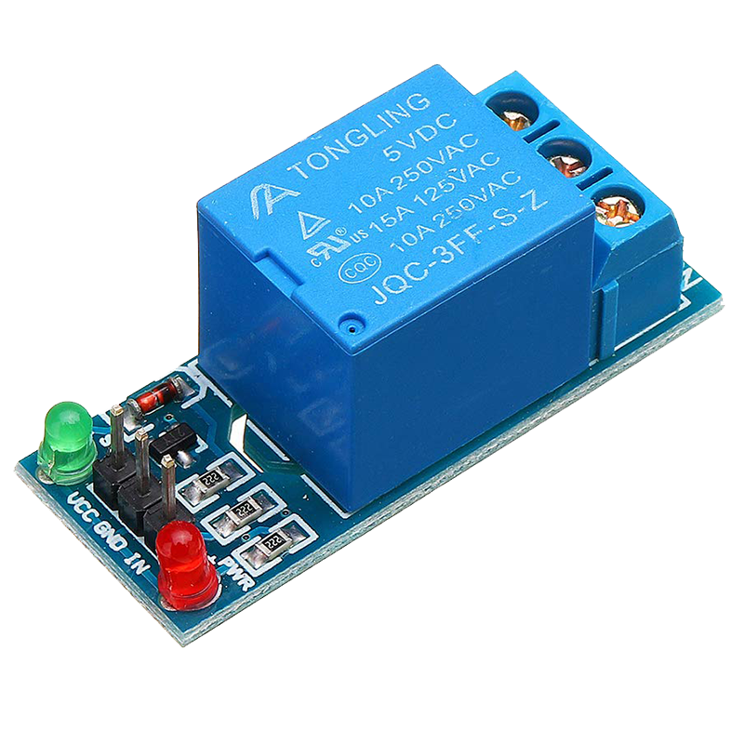
Relay Module

Slide 8
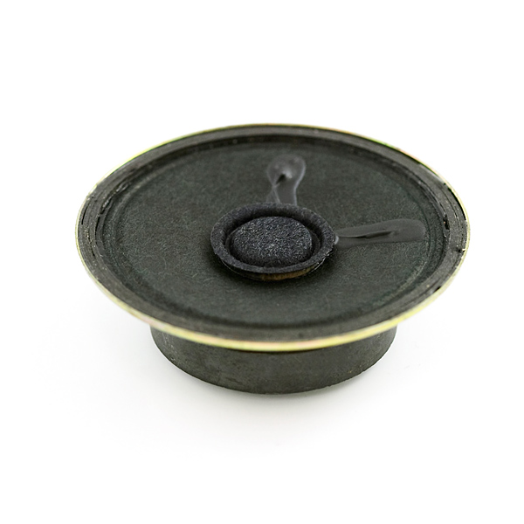
Speaker

Slide 9
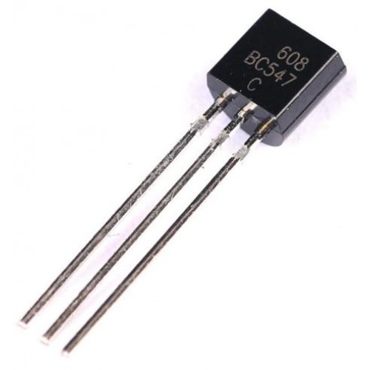
BC-547
BJT Transistor

Slide 10
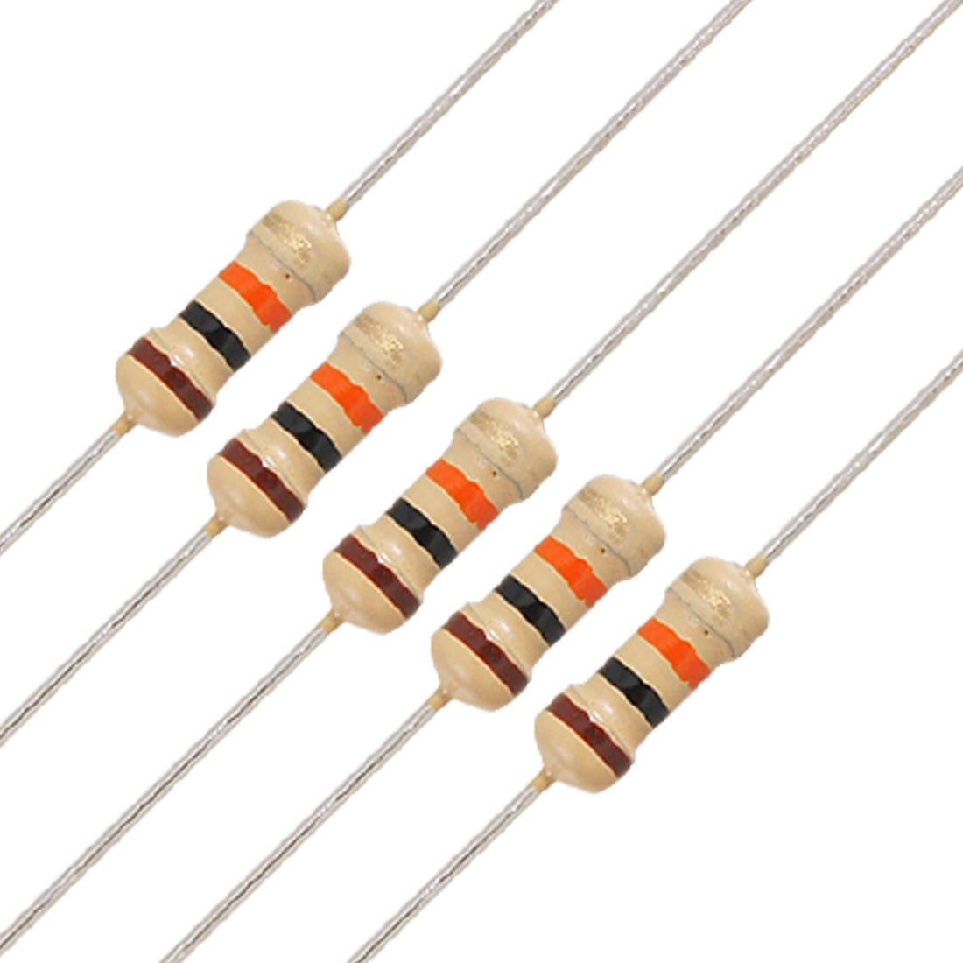
10 kΩ
Resistors

Slide 11
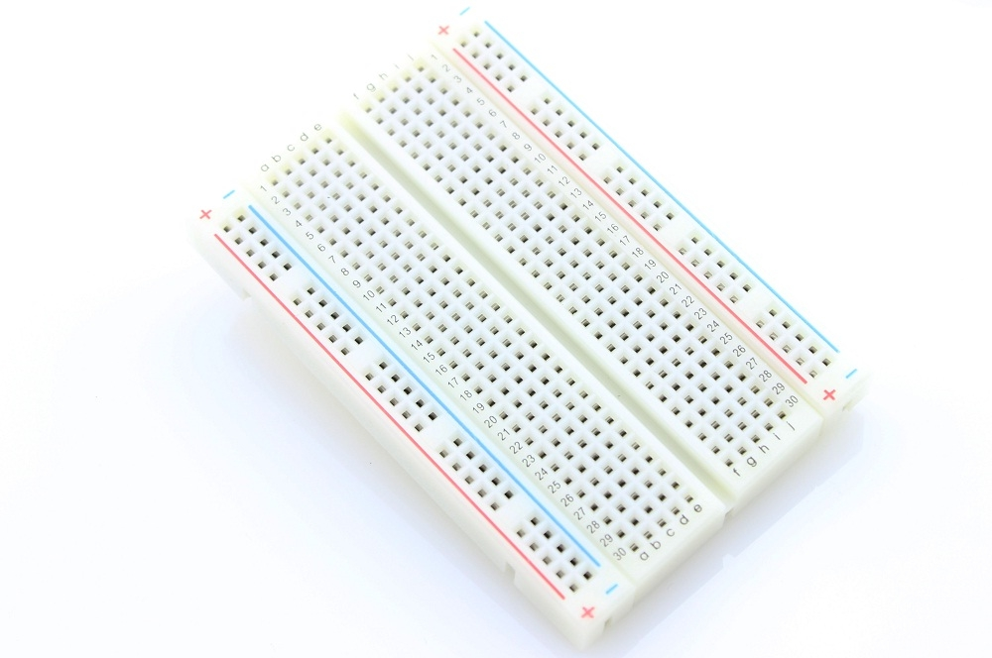
Breadboard

Slide 12
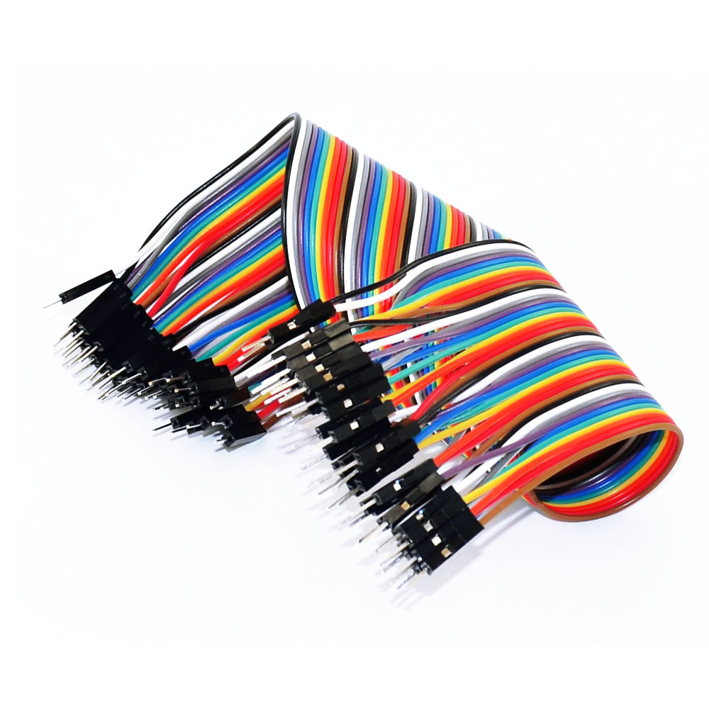
Jumper Wires

